Slide 1


BEAUTY CARE
IN TUNISIA
BY: YOSSER FHAL

Slide 2
INTRODUCTION
This project combines our rich cultural heritage with modern technology to
create a user-friendly platform that connects users with beauty services and products. The goal is to enhance accessibility, empower local service providers, and promote traditional beauty practices.
Next Page

Slide 3
OBJECTIVES
  Enhancing Accessibility: Making beauty services more available to a wider audience, including those in underserved areas.
  Empowering Local Service Providers: Providing tools for beauty professionals to manage their offerings effectively.
  Promoting Cultural Heritage: Integrating traditional beauty practices and local products into the platform to foster trust and engagement
Next Page

Slide 4
API OVERVIEW
The TAJMIL API is a RESTful web service designed to facilitate the booking and management of beauty services. It offers functionalities such as user account management, personalized beauty recommendations, and booking services. By using a modular architecture, the API ensures flexibility and scalability, allowing it to adapt to future needs and technologies.
Next Page

Slide 5
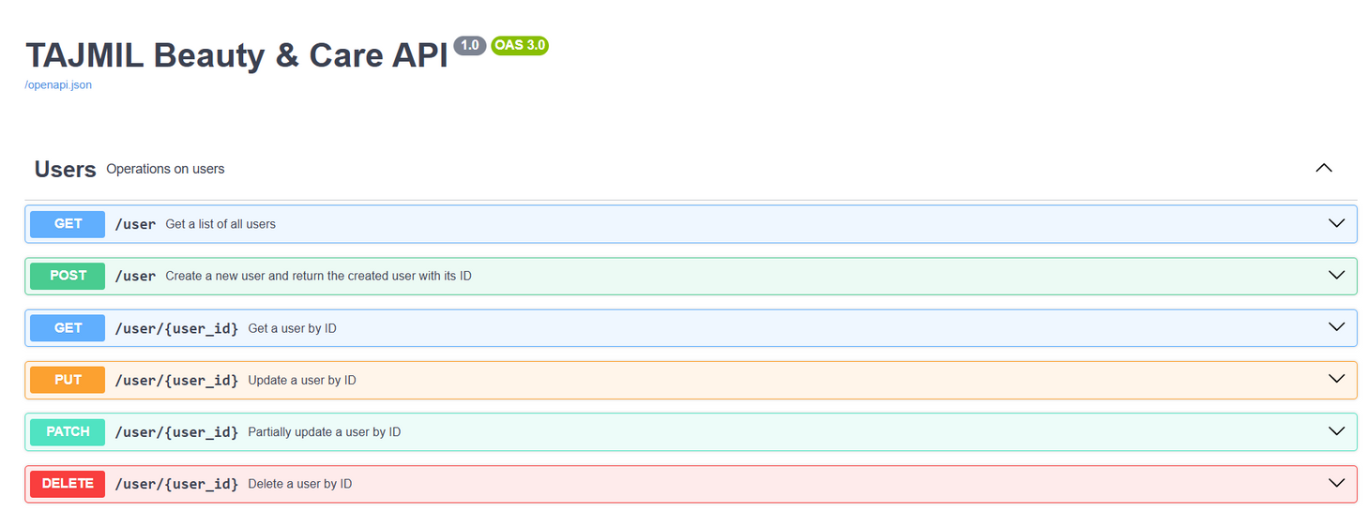
SWAGGER INTERFACE
Next Page

Slide 6
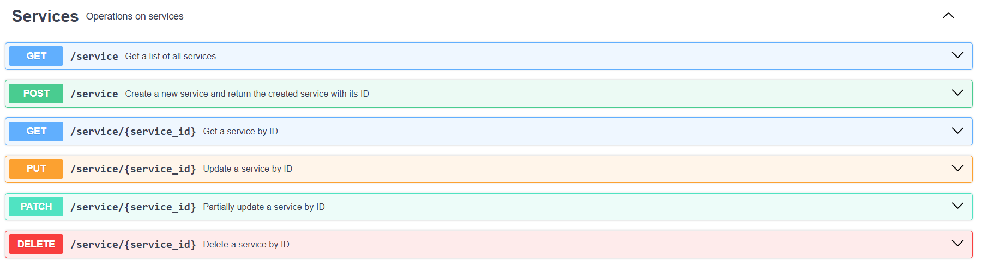
SWAGGER INTERFACE
Next Page

Slide 7
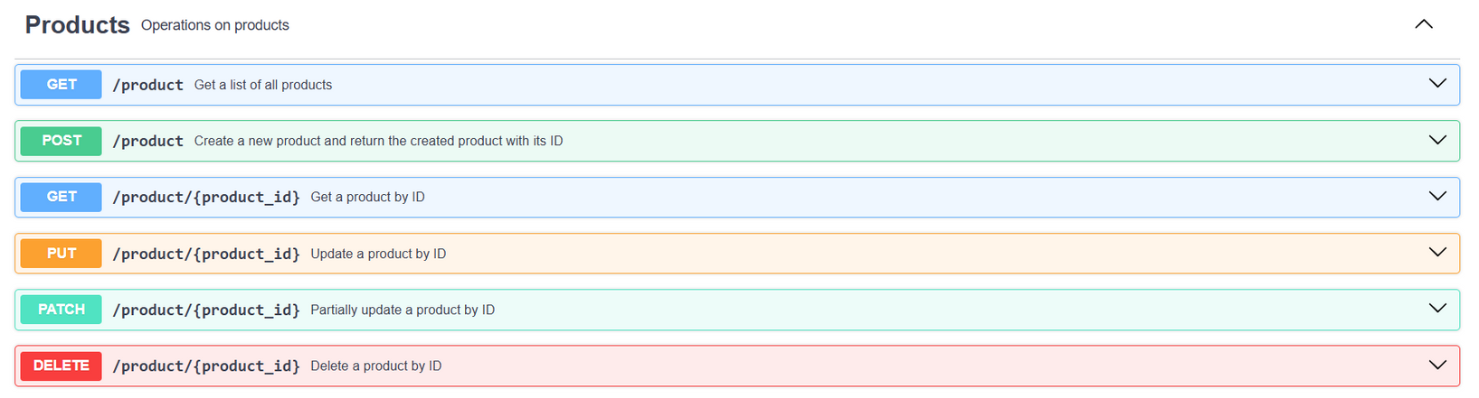
SWAGGER INTERFACE
Next Page

Slide 8
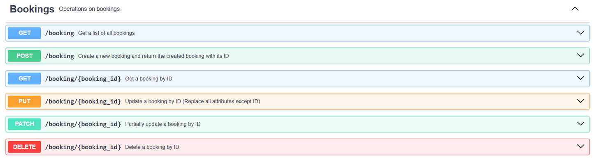
SWAGGER INTERFACE
Next Page

Slide 9
METHODOLOGY
  We began with user research to understand the needs and preferences of our target audience.
  Next, we designed the API architecture based on RESTful principles, ensuring it was user-friendly and culturally relevant.
  Finally, we conducted rigorous testing to validate the API’s functionality and reliability.
Next Page

Slide 10
DATABASE STRUCTURE
  User Model: Represents users and their booking history.
  Product Model: Contains information about beauty products available for booking.
  Service Model: Represents the beauty services offered by salons.
  Booking Model: Tracks bookings made by users for specific services.
Next Page

Slide 11
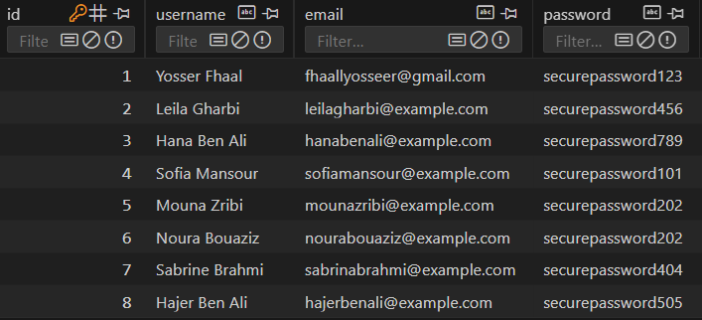
DATABASE TABLES
Next Page

Slide 12
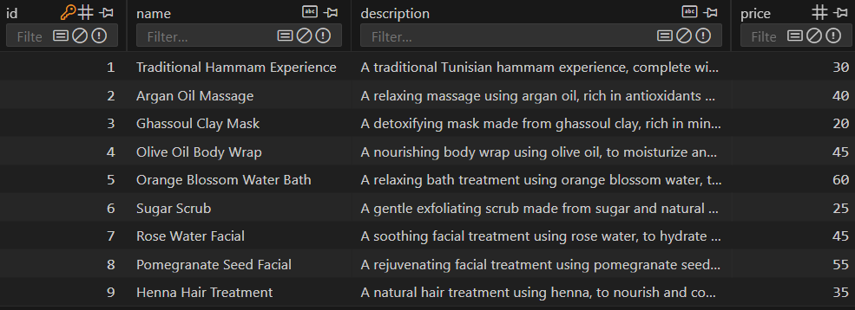
DATABASE TABLES
Next Page

Slide 13
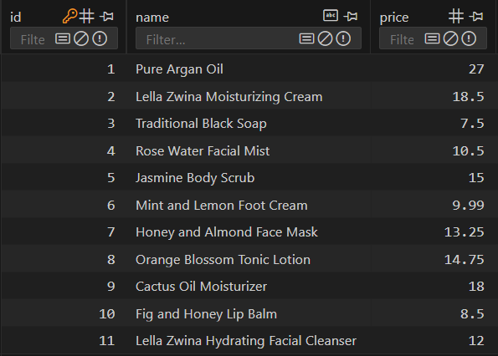
DATABASE TABLES
Next Page

Slide 14
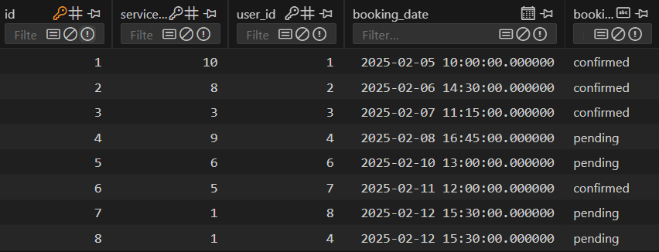
DATABASE TABLES
Next Page

Slide 15
TESTING AND VALIDATION
01
02
Ensuring data integrity in product and booking management.
Assessing the overall user experience across different cultural and linguistic contexts.
Next Page

Slide 16
FUTURE DIRECTIONS
Expanding the product database to include a wider range of local and international beauty products.
Adding OAuth authentication to enhance security
Redesigning the user interface for better navigation and user experience.
Offering loyalty programs, points, or discounts for repeat customers to encourage engagement.
Enhancing multilingual support to reach a broader audience.
Including educational content, Providing beauty tutorials, tips, and articles to educate users and build trust.
Integrating AI algorithms to improve personalized recommendations.

Slide 17
THANK YOU
FOR YOUR ATTENTION
BY: YOSSER FHAL

